Slide 1
I LOGIN THEREFORE IAM
Welcome to
Simone Stefanini
Sales & Marketing Consultant
April 12th, 2024

Slide 2


Sponsors

Slide 3



Partners

Slide 4
Agenda - Morning
10.10 Monokee
10.35 Delinea
11:00 Athesys
11:25 Panel & Keynote speech
12:10 Ingram MICRO

Slide 5
Agenda - Break
12:25 Visit to the Cellars
12:50 Lunch

Slide 6
Agenda - Afternoon
14:30 Monokee: orchestration, integration and a poll
15:20 iProov
15:30 IC Consult
15:40 Monokee: multidomain & decentralised identities
16:10 Monokee: version 4 & roadmap

Slide 7


Please, pretty please
Set your mobile phone on Silent Mode
Remain silent during the sessions

Slide 8
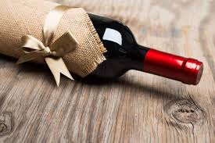
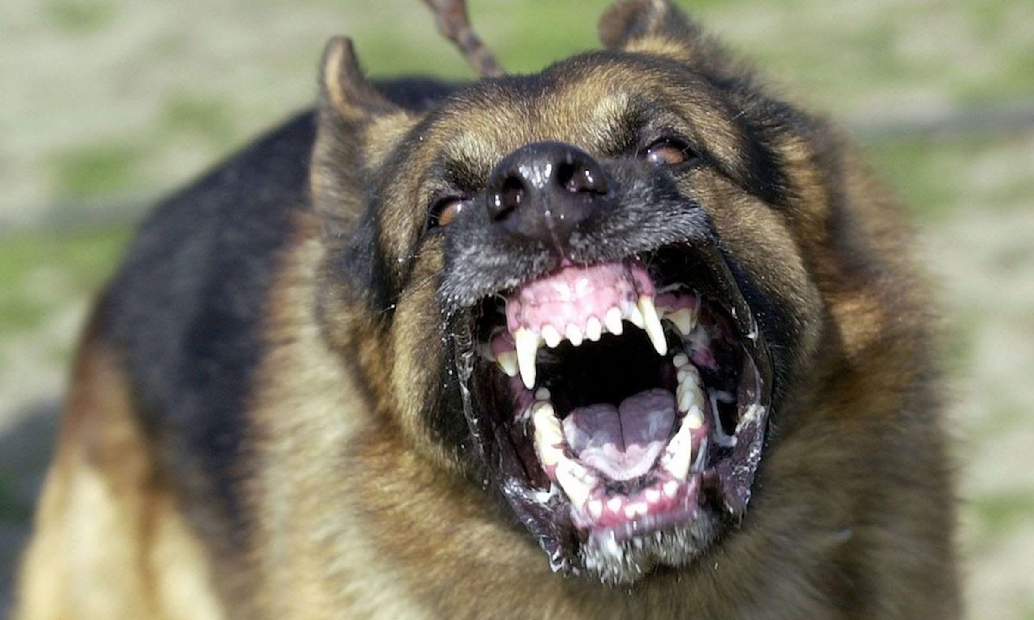
Please, pretty please
Shall I stay until the end ?
YES
NO

Slide 9
Networking anyone?
Avoid the risk of entering and leaving the event with the same network
Follow the steps and enjoy your newfound professional contacts
BONUS - you get to know where to sit at lunchtime

Slide 10
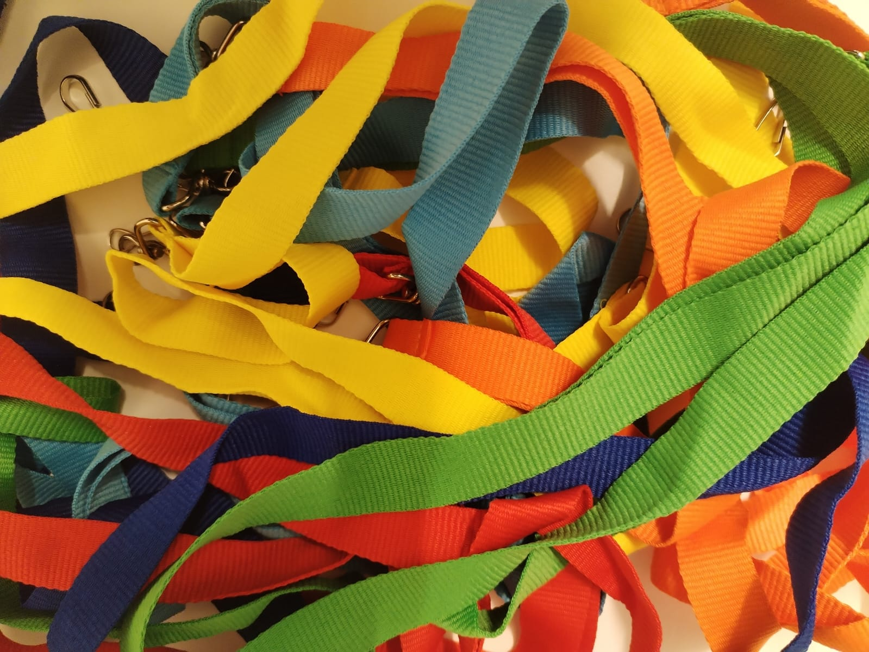
Select.Lanyard.From (BUNCH)

Slide 11

Extract.Lanyard (ONE)

Slide 12

Merge (Lanyard; Human.Neck)
+
=

Slide 13
Locate.Lanyard (SameColour)
mmm...
Is that green I see there?

Slide 14
Conversation.Engage (START)
Hey, you are green too!
Well spotted, you!

Slide 15
Professional.Network = Professional.Network + 1
Let’s talk, shall we?
Let’s talk business, shall we?

Slide 16

If Table.Colour = Laynard.Colour then SIT
Hey, I know where to sit!

Slide 17

The wine shop
10% OFF

Slide 18
Thank you for being with us today.
ENJOY the event.

